Slide 1
Impact of Cover Crops
on
Amphibian, Bird, and Insect
Diversity
Bob Brodman, Tim Rice
Saint Joseph’s College
Dan Perkins
Jasper County Soil and Water District

Slide 2
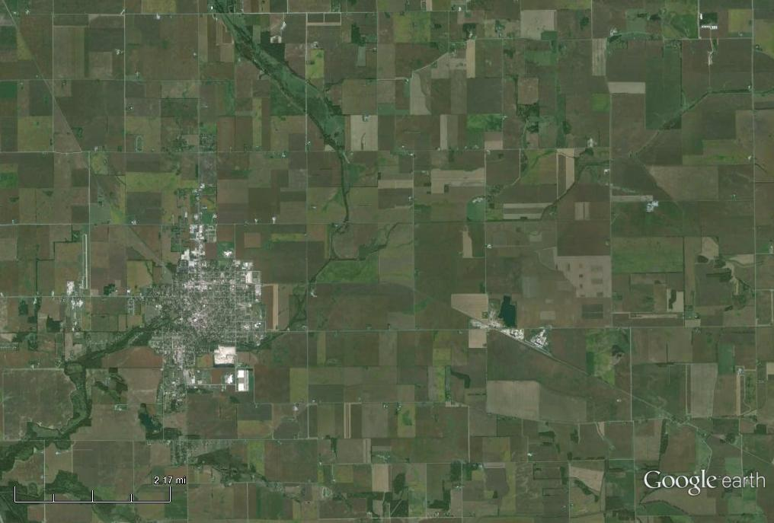
Jasper County and Rensselaer. Lots of Farmland
Rensselaer

Slide 3
Environmentally-Sound Farm Practices
No-till:
crop remainder is left standing after harvest
decreases erosion, better water retention
Cover crop
in addition to no-till, seed with another crop
increased benefits of no-till, minor cash crop

Slide 4
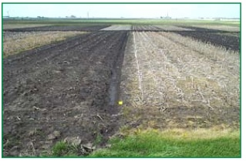
Till No-till

Slide 5
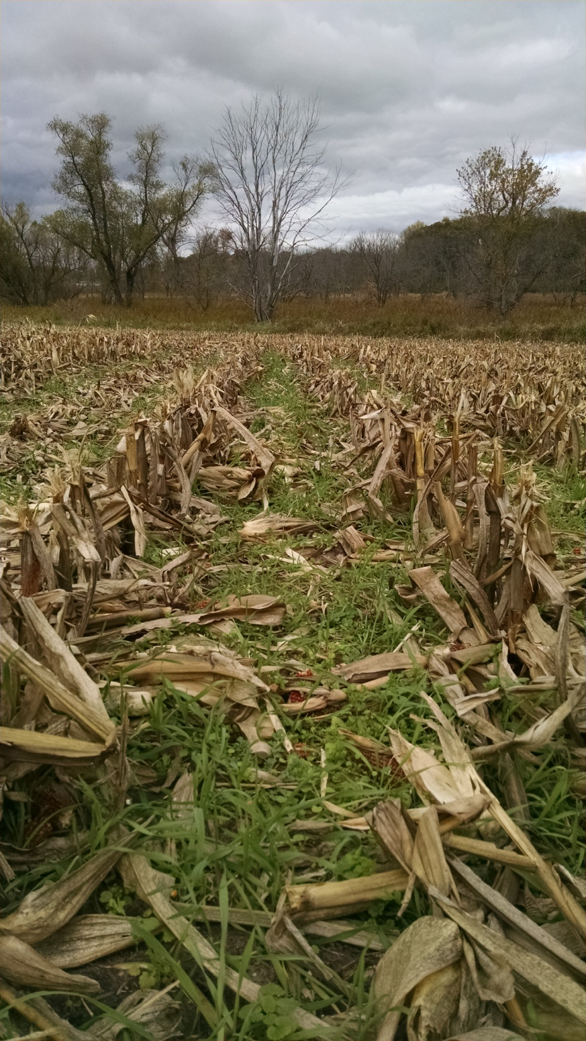
Cereal Rye cover Crop
amid Corn Rows

Slide 6
Impacts on Wildlife
Well-known for no-till
improved water quality (Vaché et al., 2002)
use by nesting birds (Basore et al., 1986; Duebbert and Kantrud, 1987)
lower mortality of amphibians (Kingsbury and Gibson, 2011)
Cover crop, almost no data
increased rodent pests (Wiman et al., 2009)

Slide 7
Grant Opportunity: National Wildlife Federation
Subject 1: Research on quantifiable direct impacts of cover crops to wildlife
The purpose of this research is to assess and interpret the wildlife habitat values of cover crops, including topics such as:
1. Nesting numbers and success
2. Incidence of trap habitat where cover crops result in nest losses due to providing habitat that is subsequently destroyed for planting of commodity crops
3. Forage availability and impact on various wildlife and avian populations
4. Impacts on pollinator health and populations

Slide 8
Excellent Fit for SJC:
We have a Wildlife Ecology Track in Biology, history of excellent undergrad field work
Lots of corn and soy fields,
    including campus property
Connections to local farmers for control sites
In-house expertise: amphibians, birds, insects, soils, crops
One faculty member (entomologist) offered his farm property, which was already used for course and research fieldwork

Slide 9
Methods: Field Sites
Winter-Spring 2014: Identified matching control and treatment sites
-approximately 60 acre
-farm field, wetland, wooded area
Coordinated Sampling among 2 advisors,
2-4 students
Students had the opportunity to sample all organisms

Slide 10
Haskell Control
Rensselaer

Slide 11
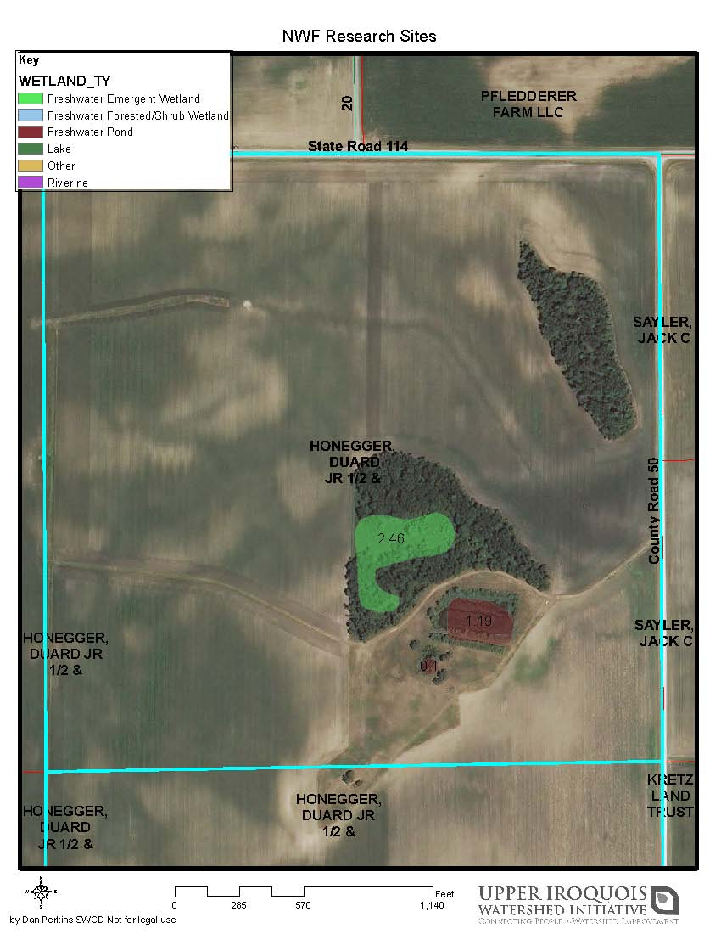

Slide 12
Haskell Treatment
Rensselaer

Slide 13
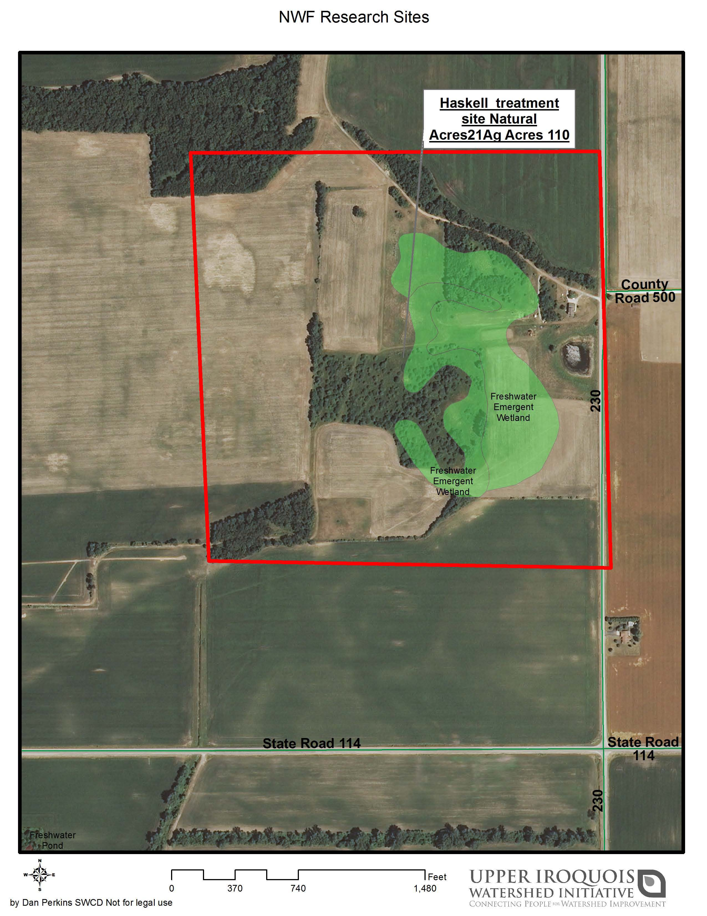

Slide 14
Saint Joe Control
Rensselaer

Slide 15
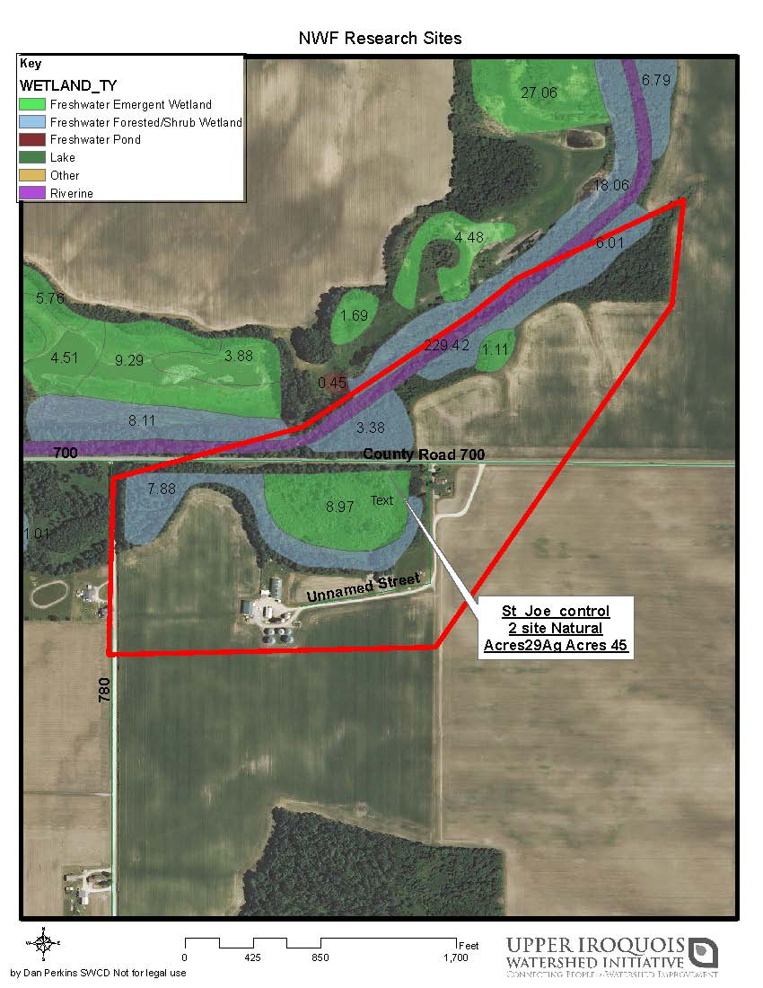

Slide 16
Saint Joe Treatment
Rensselaer

Slide 17
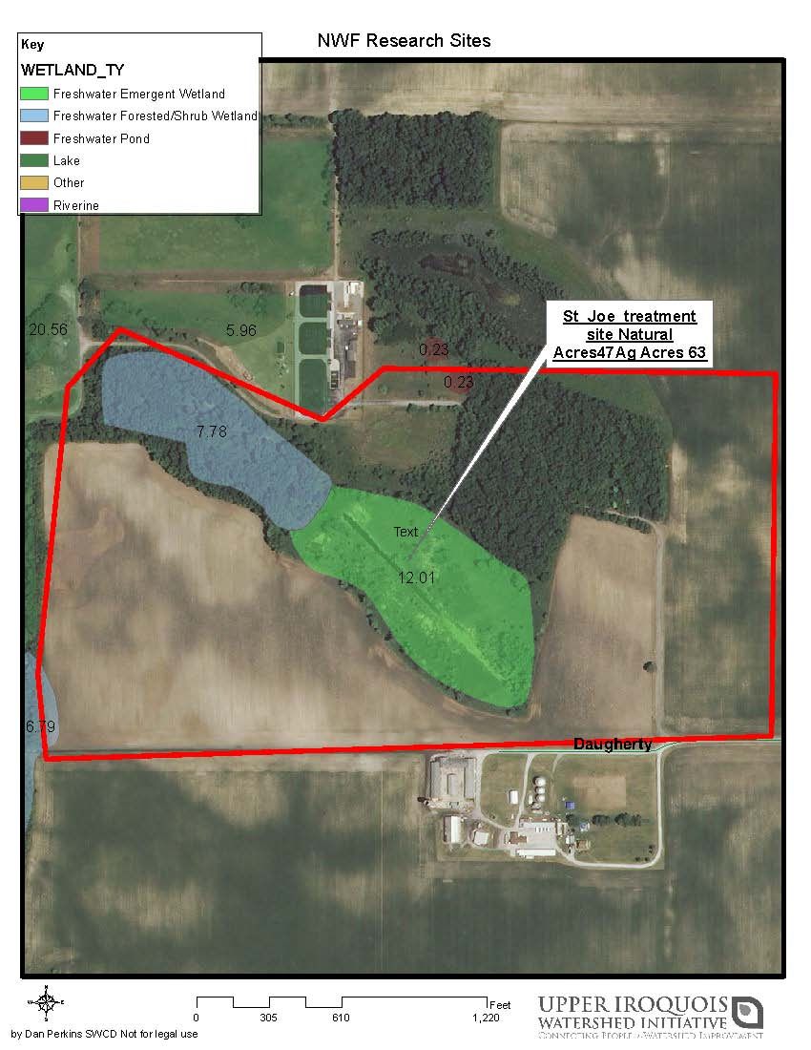

Slide 18
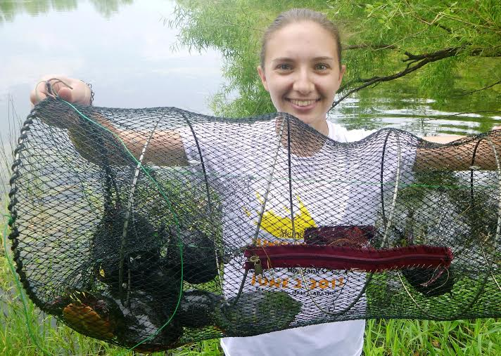
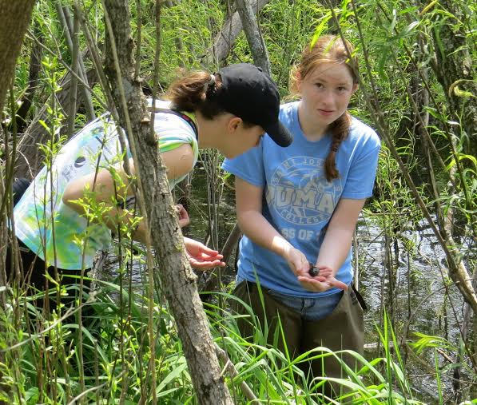
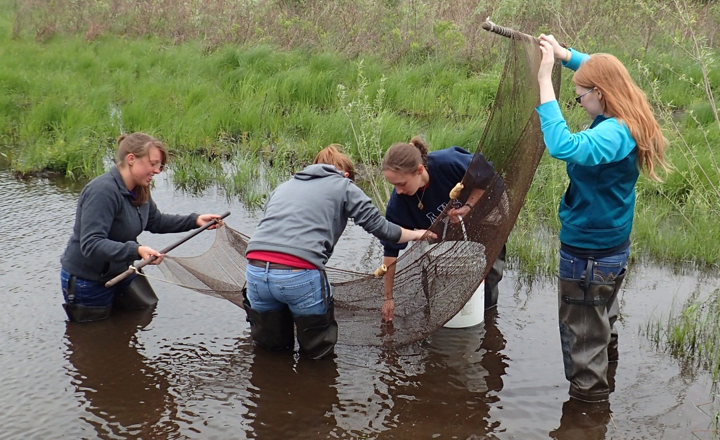
Methods: Amphibians April-June
6 cover boards per plot
Breeding activity in wetlands
--frog call surveys
--minnow traps, dipnet, seine for larvae
--12 dates on each treatment & control

Slide 19
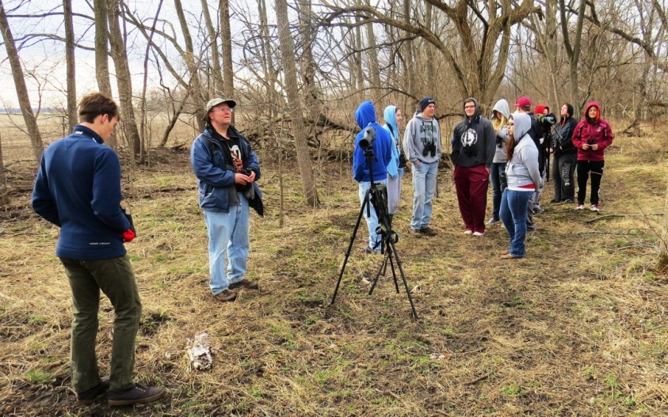
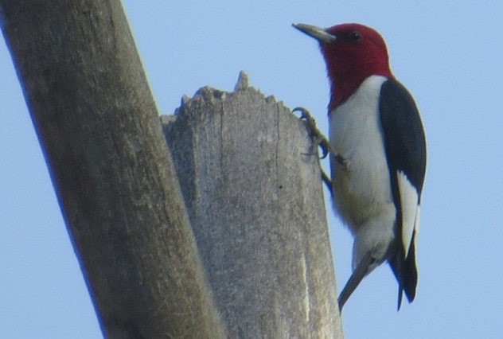
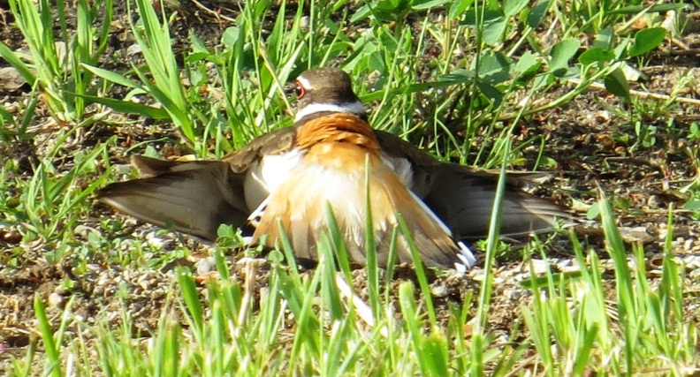
Methods: Birds May-July
Each site sampled 5 times: the whole area 8am-noon
Residents only:
    --species that would be around during cash crop AND cover crop planting
    -perhaps same individuals throughout the project
Visual and vocal: number of observations, not individuals
Inspection of breeding: nests, carrying nest material, feeding young

Slide 20
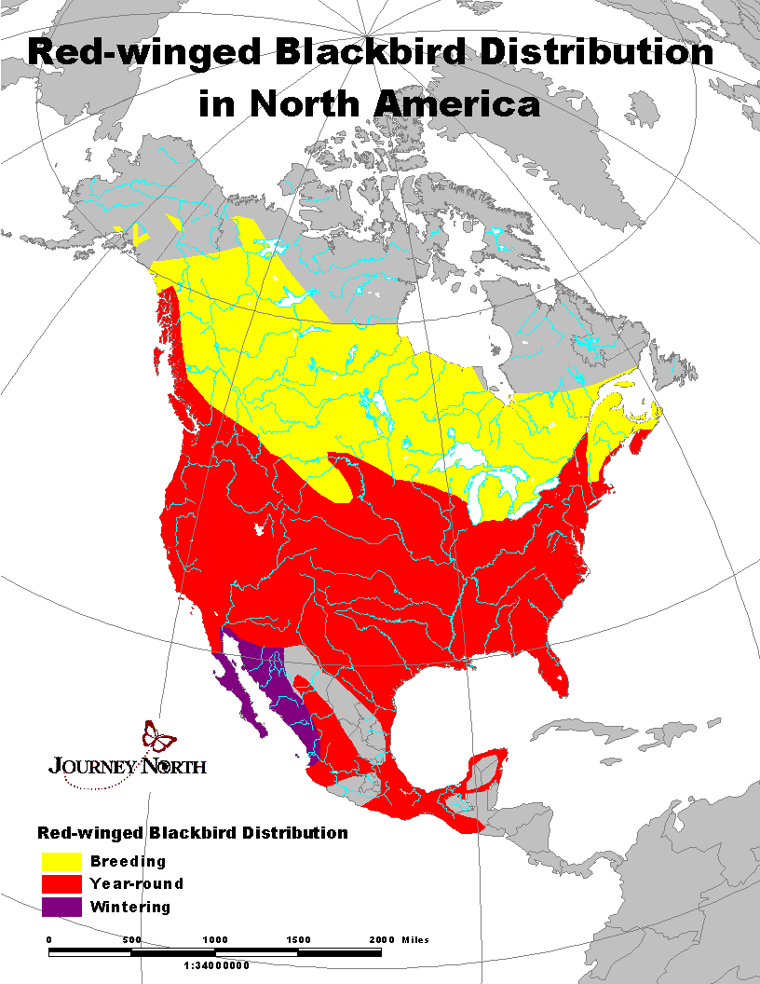
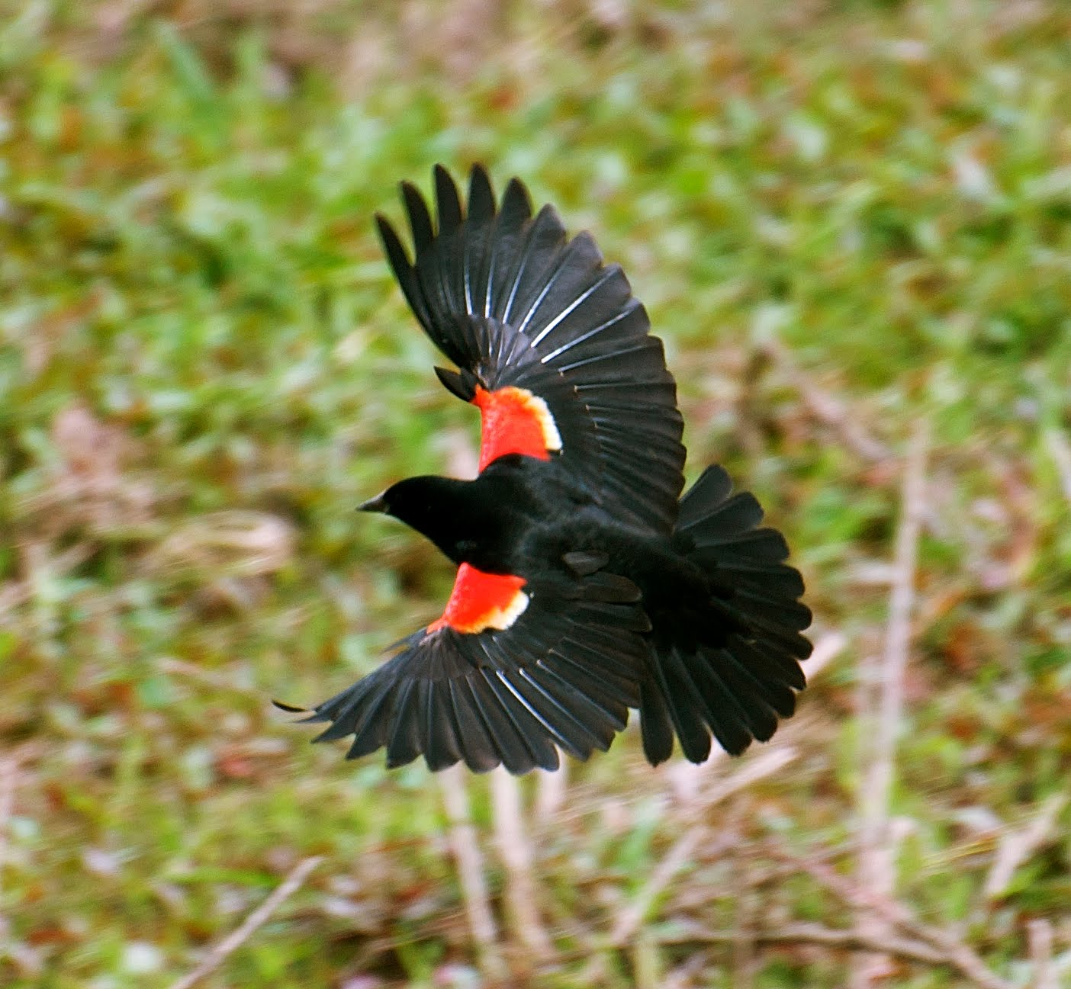
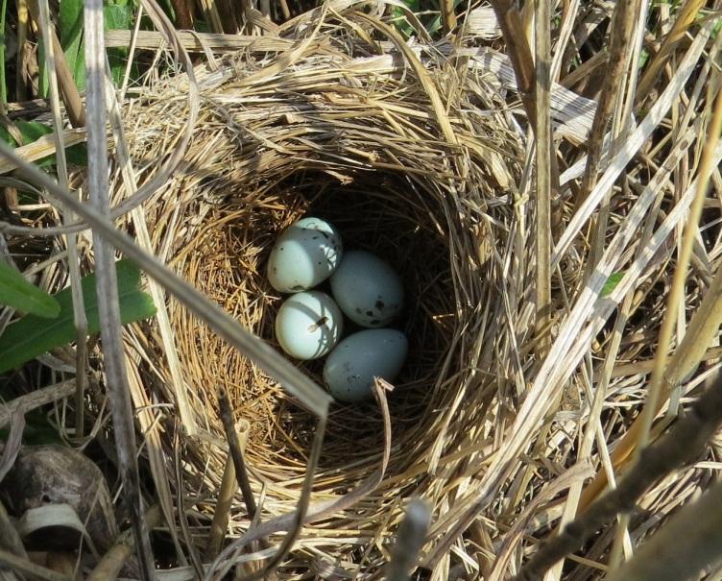
Example Resident Bird

Slide 21
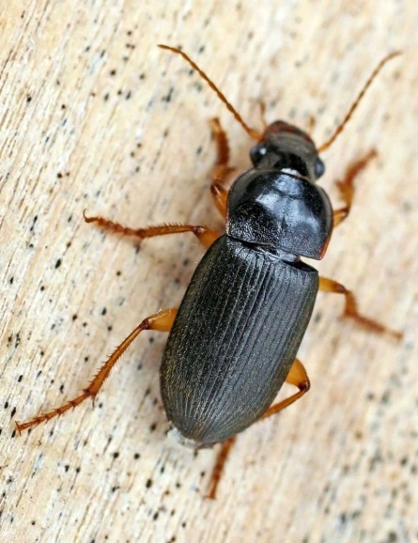
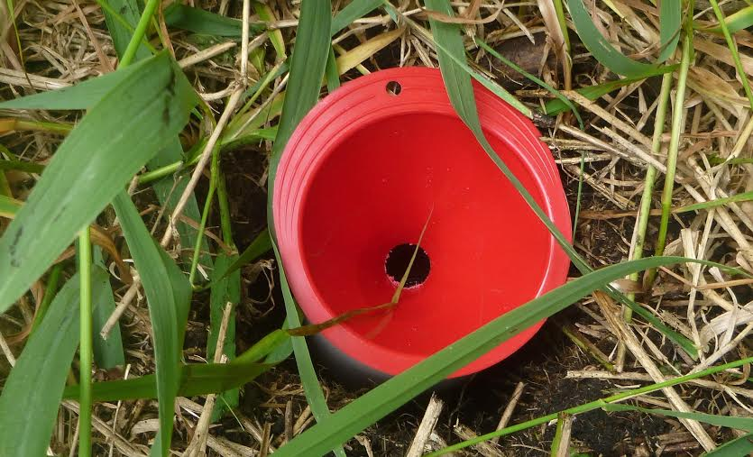
Methods: Ground Beetles, Carabidae
6 dates Mid-June-Mid-July
Sampled from areas between edge of woodlands and agricultural fields within each of the four sites.
Sampled from under six cover boards and six pit fall funnel traps at each plot.
Easy to trap, count,
  indicate presence of other insects

Slide 22
Results: Amphibian baseline (2014)

Slide 23
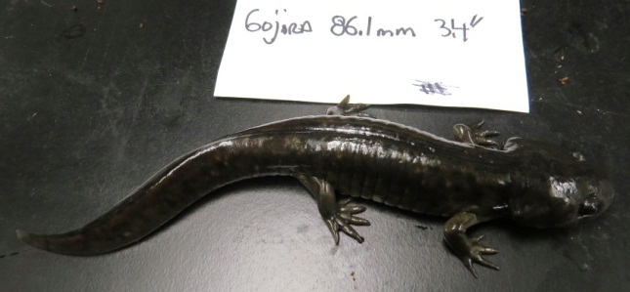
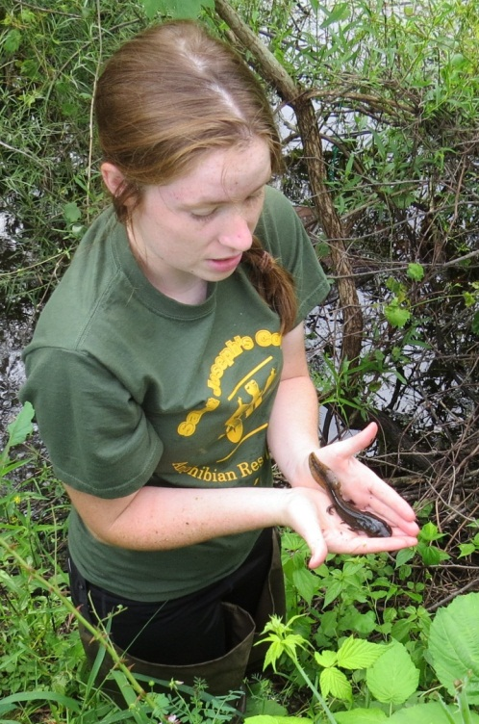
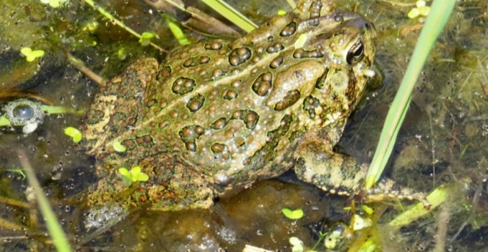
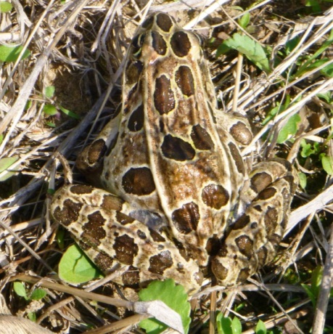
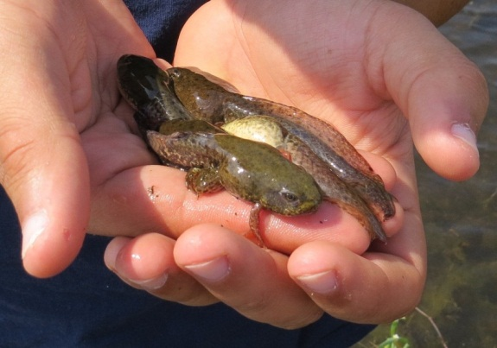
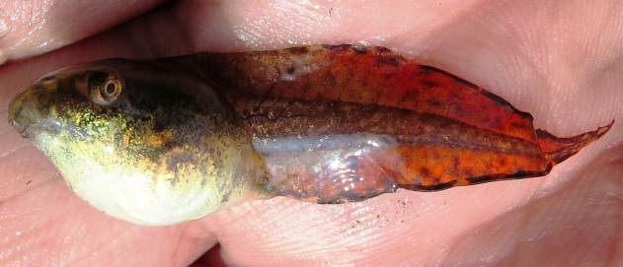
Results: Amphibians
10 species and a total of 1816 amphibians
Tiger Salamanders, Green Frogs, Northern Leopard Frogs, and American Toads
No significant difference in
  abundance per day (P = 0.23)
  diversity (P = 0.12),
  species richness (P = 0.10)

Slide 24
Results: Bird baseline (2014)

Slide 25
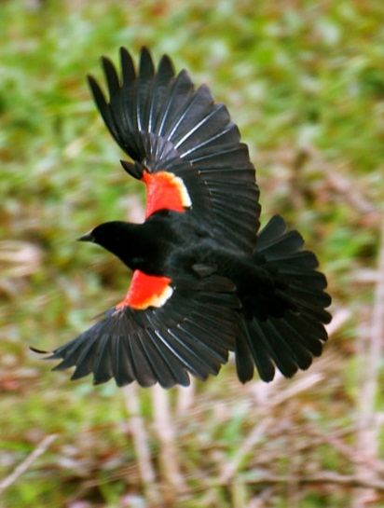
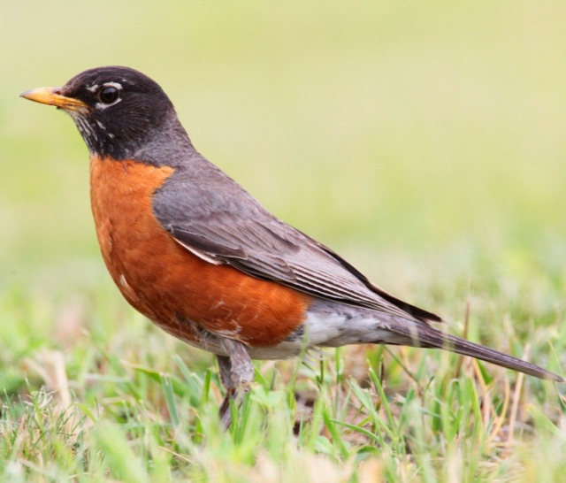
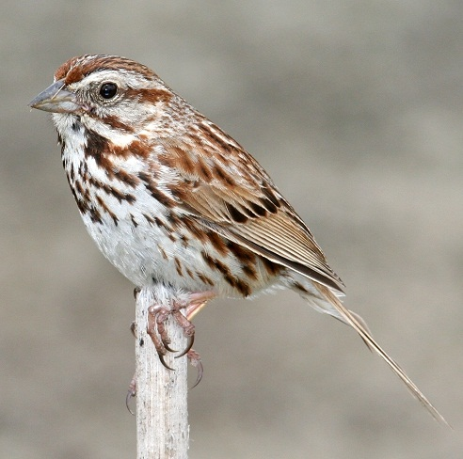
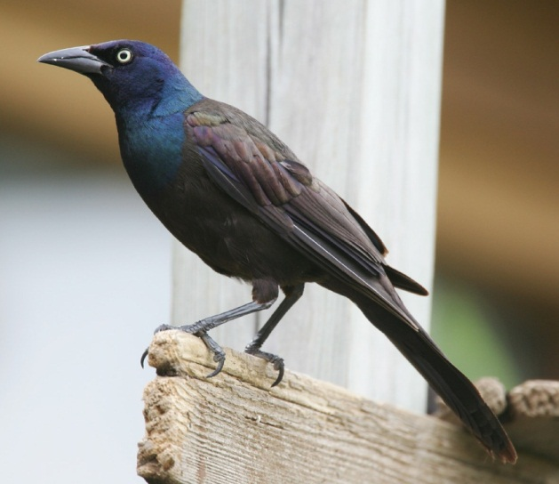
Results: Birds
37 species and 1314 observations
Red-winged Blackbird, American Robin, Song Sparrow, and Common Grackle.
No significant difference
  abundance per visit(P = 0.14)
  diversity (P = 0.40
  But significantly more species at treatment compared to control plots (P = 0.03)

Slide 26
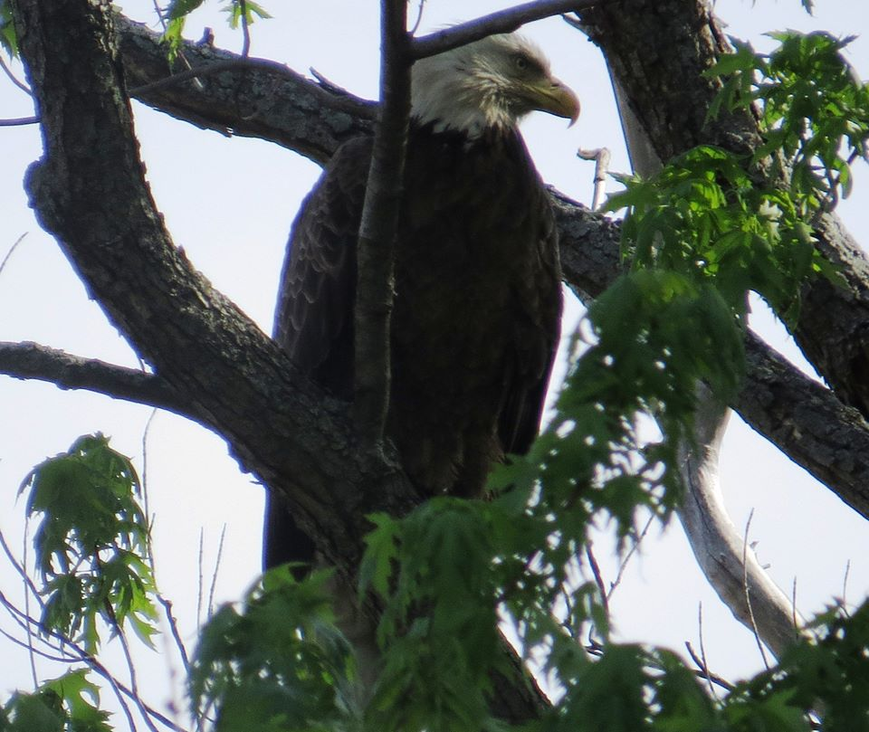
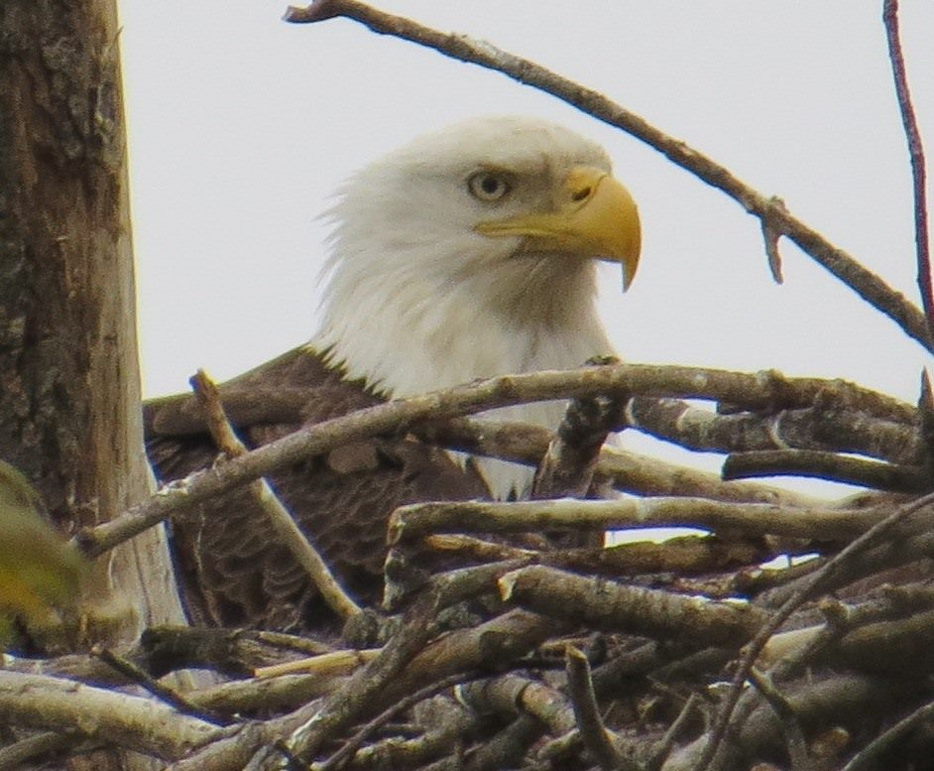
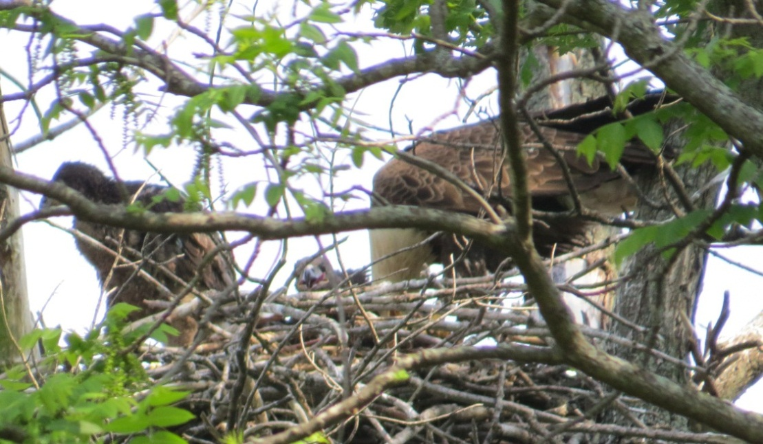
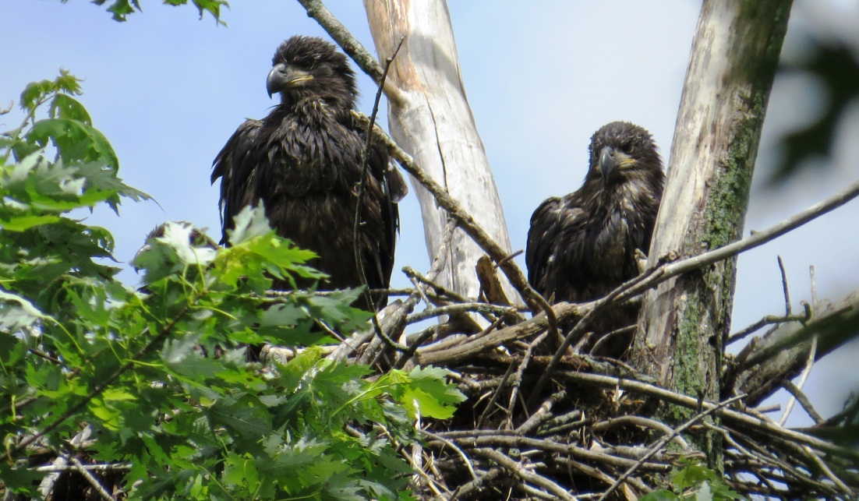
Bald Eagles

Slide 28
Results: Ground Beetle baseline (2014)

Slide 29
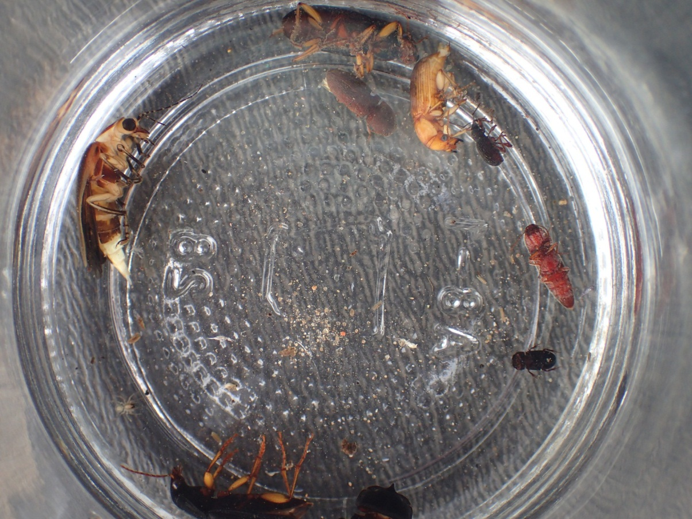
Results: Beetles
24 species and 102 observations
No significant difference
  abundance per visit (P = 0.25)
  diversity (P = 0.46)
  species richness (P = 0.25)

Slide 30
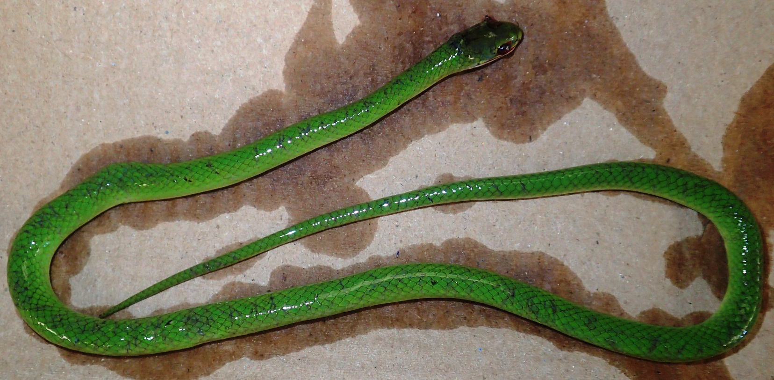
Other notable species
Rough Green Snake: State endangered
Many migratory birds (Warblers)
Mink

Slide 31
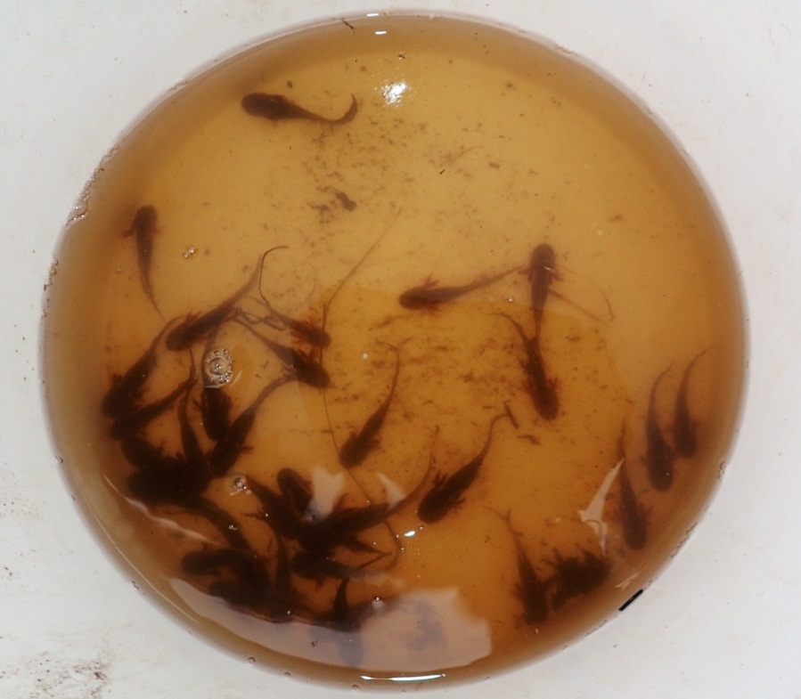
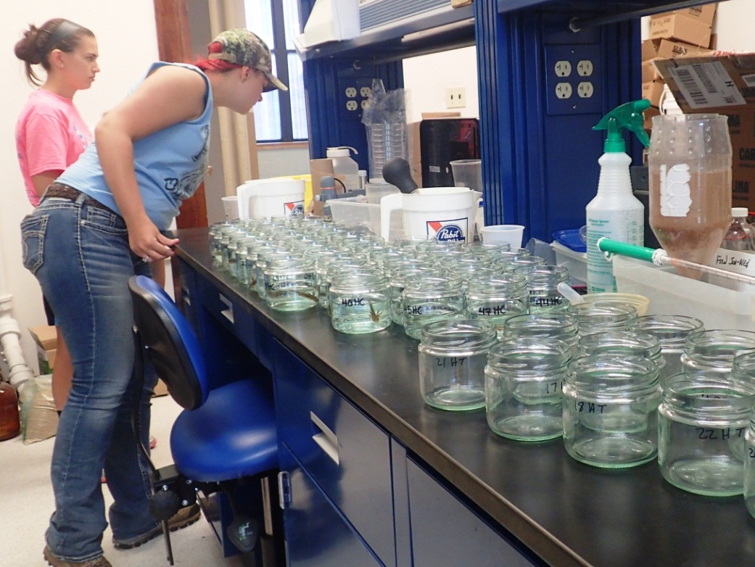
Herbicides & Amphibians
Cover crop often terminated by using herbicide during amphibian development
Collected 24 Tiger Salamanders from each control & treatment site; exposed half to Roundup
Roundup treated smaller, less developed, more abnormalities (P < 0.05)

Slide 32
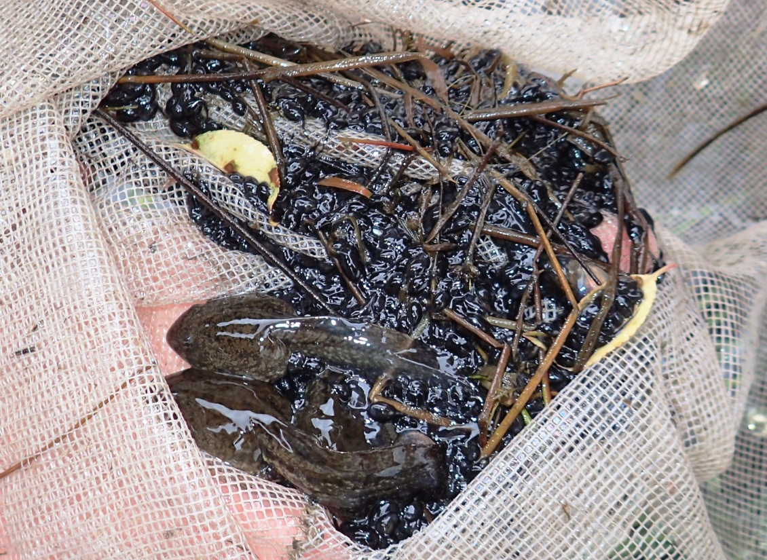
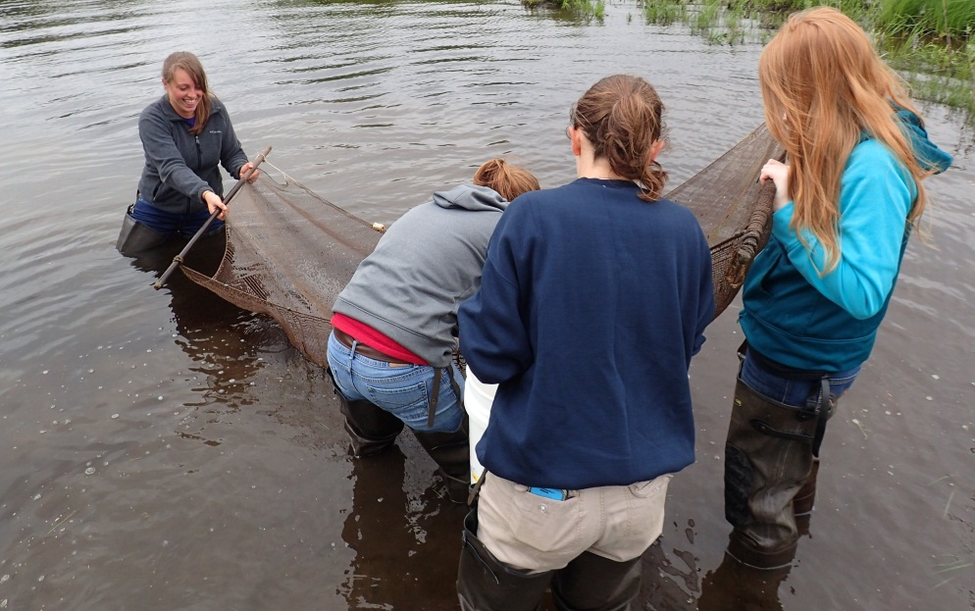
Conclusions
Sites have suitable habitat for amphibians, birds, & beetles
Paired controls & treatments are similar
Great experience for students

Slide 33
Fall 2014: Cover Crop Application
Established along edge/ entire cropland of the edge of the wetland-woodland complex at each treatment site.
Cereal rye aerial seeded ahead of soybeans, and aerial seeding of oats, radish ahead of corn in 2015
Termination of the cover crop will occur 2-3 weeks before the 2015 cash crop is planted to fit in with current cropping sequences in the area.

Slide 34
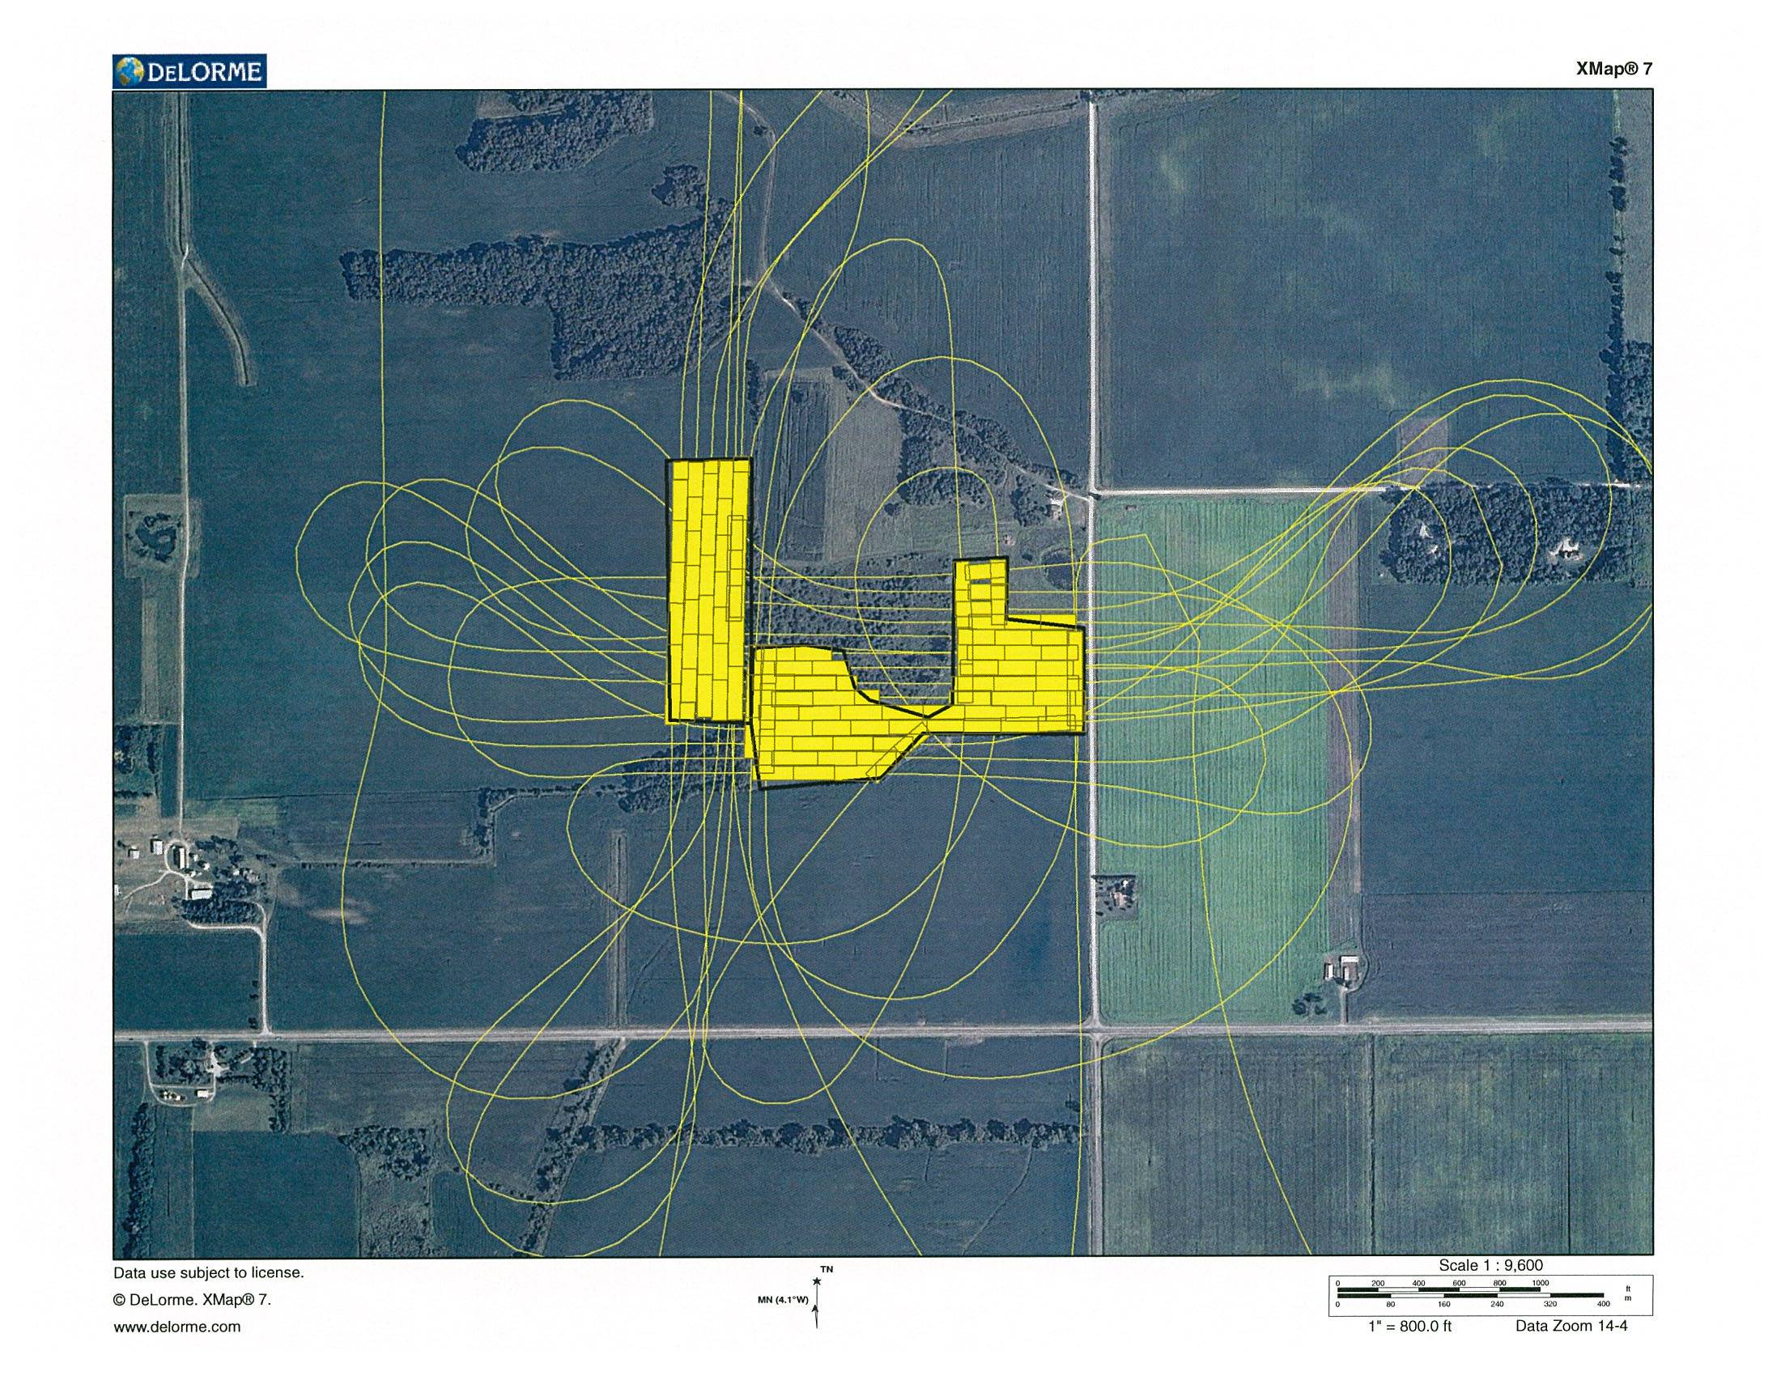
Haskell Treatment

Slide 35
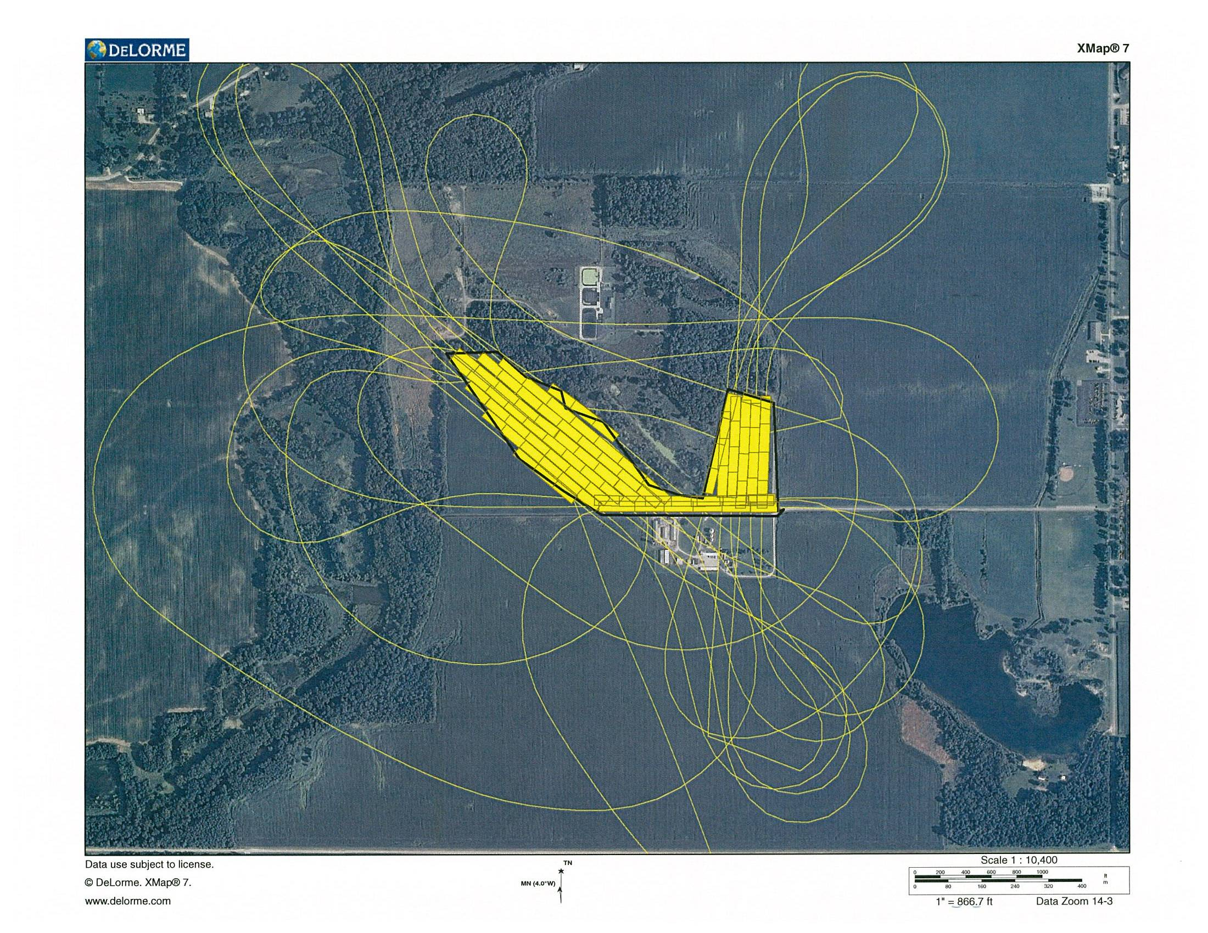
Saint Joe Treatment

Slide 36

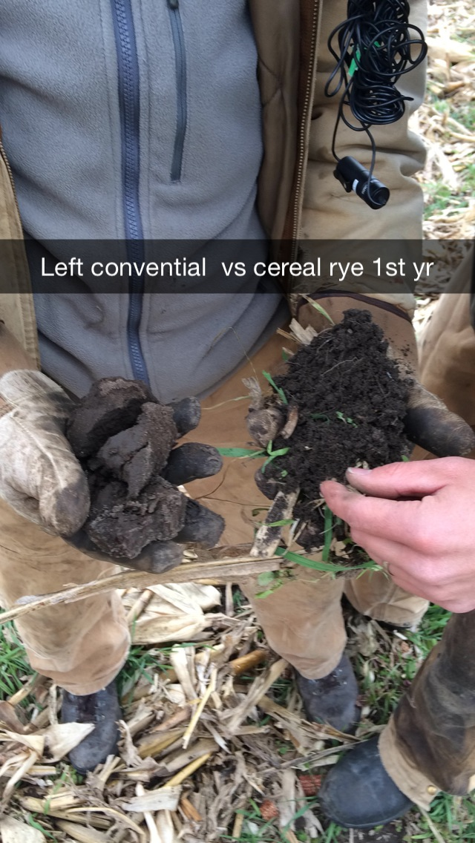
Saint Joe Site

Slide 37
Spring 2015
Field season in progress
Birds: 5 visits per site
Amphibians: 12 visits per site, however one site is currently under the river
Beetles: 3 collections per site
Summer 2015: finish field work
Fall 2015: plant new cover crop

Slide 38
Summary
After Year, matched control and treatment plots appear equivalent prior to cover crop application
Year 2: will cover crop have an effect on target groups?

Slide 39
Acknowledgements:
-Dr. Neal Haskell: treatment plots, insect expertise
-Dr. Anne Perez: beetle identification
-Jasper SWCD Cover Crop Cost Share
-Brusnahan and Honneger Families for control sites
-Students:
Payton Kellenburger, Emily Baird, Hanna VanMeter, Rick Mullis, Bailey Bickel, Jacob Villalpando, Jessica Nagel, Allyson Roller, Haley Mitchell
-Andrea Strang, Jeff Grider, Arlene Angelo, Jeremiah Fields
-SJC for summer housing, additional funding for student interns from NPS, IAS

