Slide 1
Meat Goat Production for Ethnic Populations PFI Annual Conference January 20-21, 2017 Ames, IA

Slide 2
Our History
Deb
Evan
Ethan
Eric

Slide 3
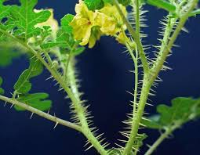
Goat 101
Three most common meat breeds
Boer, Kiko, Spanish
Kidding season
Photo-sensitive this far North
Offspring
Single, twins and triplets
Do prefer browse (80%) to grass (20%)

Slide 4
Meat Breeds: Boer
Traditionally white with red head
Originated in South Africa
Most popular show breed
Helped meat goats quickly gain in popularity in the 1990s
Cull faults
Average adult weight (F): 140-160 lb

Slide 5
Meat Breeds: Kiko
More color variation-often white or cream but also black or tan with black accents
Developed from feral New Zealand goats crossed with Nubian dairy goats
Dual purpose-meat and milk
Gaining in popularity
Parasite resistance
Horns
Average adult weight (F): 90-105 lb

Slide 6
Meat Breeds We Utilize
Kiko
Aggressive foragers
Parasite resistance
No extra teats
Boer
Dominant color
Muscling
Kids in 4H
Kiko
Boer

Slide 7
Meat Breeds: Spanish
Usually black or black with tan underbelly
Originally brought to New World by Spaniards
Moved West from Caribbean Islands and North from Mexico-Popular in Southwestern U.S. (tolerate a hot, dry climate)
Dual purpose-meat and milk
Average adult weight (F): 105-120 lb

Slide 8
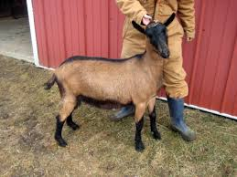
Meat Breeds: Everything Else
Myotonic (Fainting) goats
Cashmere goats
Pygmy goats
Dairy goats-cull does, wethers

Slide 9
Ethnic Consumers
2/3 of the world’s population eats goat meat: Hispanic, Caribbean, Asian, African, Middle Eastern, South American
Want to purchase a fresh product

Slide 10
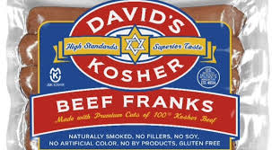
Religious Preferences
Halal Certified
(Muslims)
Kosher
(Jewish)
Specifications as to animal
positioning during kill,
who kills, and how meat is
processed

Slide 11
Ethnic Preferences
Middle Eastern
Larger size (70-100 lb)
Male-must be castrated; will NOT eat a female
Processed at local locker (more disposable income)
Multiple goats packaged separately

Slide 12
Ethnic Preferences
African
Adult goats-old ok
Either male or female
Processed themselves, often by scalding

Slide 13
Ethnic Preferences
Hispanic
Primarily 40-60 lb goats, though total dollar amount more of a consideration
Prefer white goats with colored head
Wethers, does or intact young bucks
Processed themselves

Slide 14
Market Facts
80% of goat meat consumed in the U. S. is IMPORTED!
Lack of industry infrastructure (slaughter facilities)
Greatest demand is for 50-70 lb goats (under 1 yr of age)
Prices: Summer lows; highest price usually Dec-Feb; Easter spike
Dressing percentage: 50%
Goat meat doesn’t marble
Notes:
Early 1990s US EXPORTED goat meat. Chg in demographics. 3 federally inspected plants-2 in NJ and 1 in NY. Dressing % of pig 74%; cattle 60%; lambs 54%

Slide 15
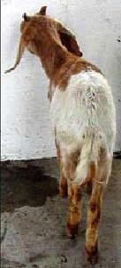
Know the Meat
Selection 1 Selection 2 Selection 3

Slide 16
Know the Meat
USDA Report
Kalona, IA 1/11/2017
Slaughter Kids Selection 1
Head Wt Range Avg Wt Price Range Avg Price ($/lb)
1 85 85 145.00 145.00 1.71
1 90 90 185.00 185.00 2.06
1 110 110 185.00 185.00 1.68
Selection 1 (Heavywt) Avg Price: $171.67/goat

Slide 17
Know the Meat
Slaughter Kids Selection 1-2
Head Wt Range Avg Wt Price Range Avg Price ($/lb)
11 41-46 44 120.00-130.00 125.44 2.85
Selection1-2 (Middlewt) Ave Price: $125.44/goat
Slaughter Kids Selection 2
Head Wt Range Avg Wt Price Range Avg Price ($/lb)
3 36 36 82.50 82.50 2.29
1 55 55 120.00 120.00 2.18
21 60-61 61 125.00-145.00 127.82 2.10
1 70 70 150.00 150.00 2.14
Selection 2 (Middlewt) Ave Price: $123.14/goat

Slide 18
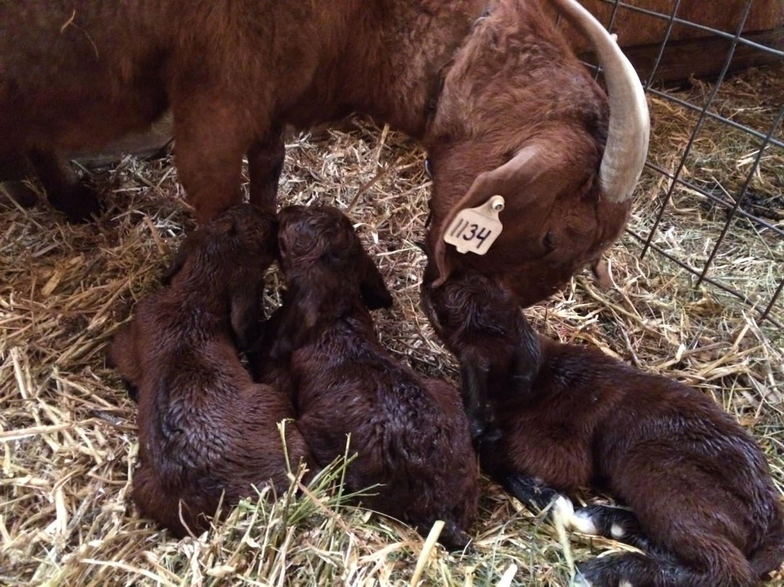
Marketing Options
Direct to Slaughter Facility
Auction market/Sale barn
Slaughter facility
Direct to Consumer
Farmer’s markets
Custom/Local locker
Off farm

Slide 19
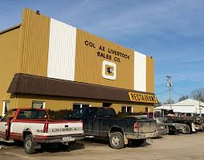
Marketing Options: Direct to Slaughter
Auction Market/Sale Barn
Not a set price
Lose potential income with commission, yardage, inspection, etc.
Is usually a location not too far from home

Slide 20
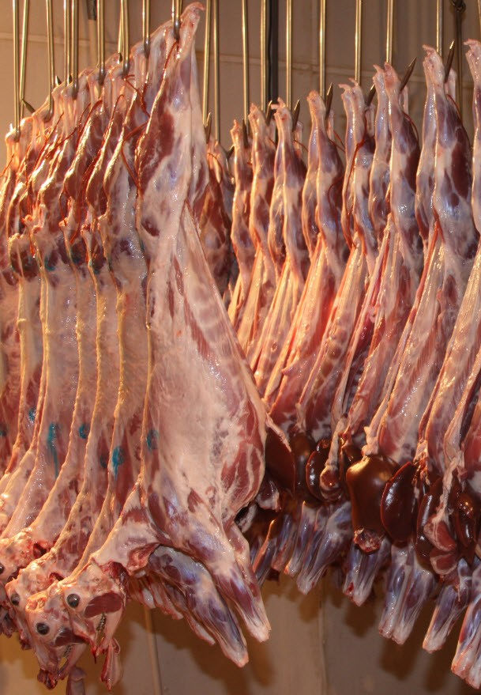
Marketing Options: Direct to Slaughter
Slaughter Facility
Price set prior to arrival
Could be farther away (increased trucking expense)
No commission expenses

Slide 21
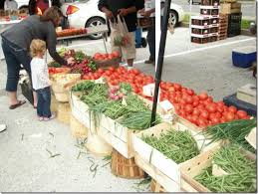
Marketing Options: Direct to Consumer
Farmer’s Markets
Time commitment
Costs-licensing, booth fee
Ability to keep meat at correct temperature
Meat must be inspected
Easy advertising

Slide 22
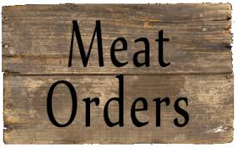
Marketing Options: Direct to Consumer
Custom/Local locker
Some degree of wait time for consumer
Can be cut to their desiring
Meat stamped “not for resale”
Facilities are inspected, not the meat

Slide 23
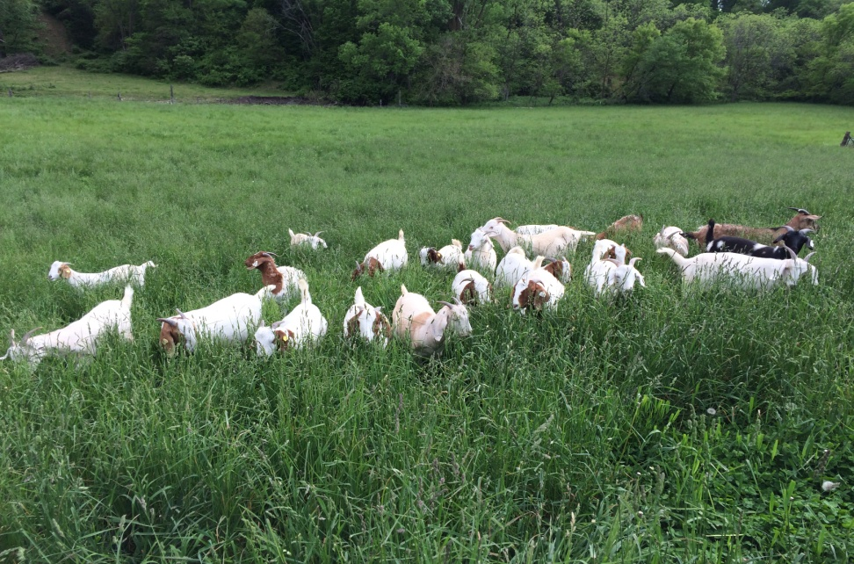
Marketing Options: Direct to Consumer
Off Farm
You determine price
No trucking, commission charges
Inconvenience of unexpected visits
Irregular income
Processing too?

Slide 24
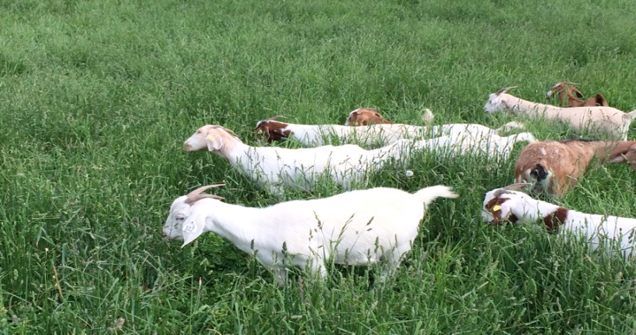
On Farm Processing
USDA allows for on-farm slaughter by the owner of the animal
Insurance-liability on property owner
Inspection-what type of facilities

Slide 25
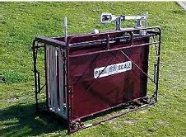
Our Marketing: Direct Off Farm
Started due to demand, but no supply
Determining Price
Scale as tool-not certified
Based on $/lb off current market trends
Don’t haggle!
On farm processing
Notes:
Small premium on price-getting choice; clean up mess; changed qtrly; nearest 25 cents

Slide 26
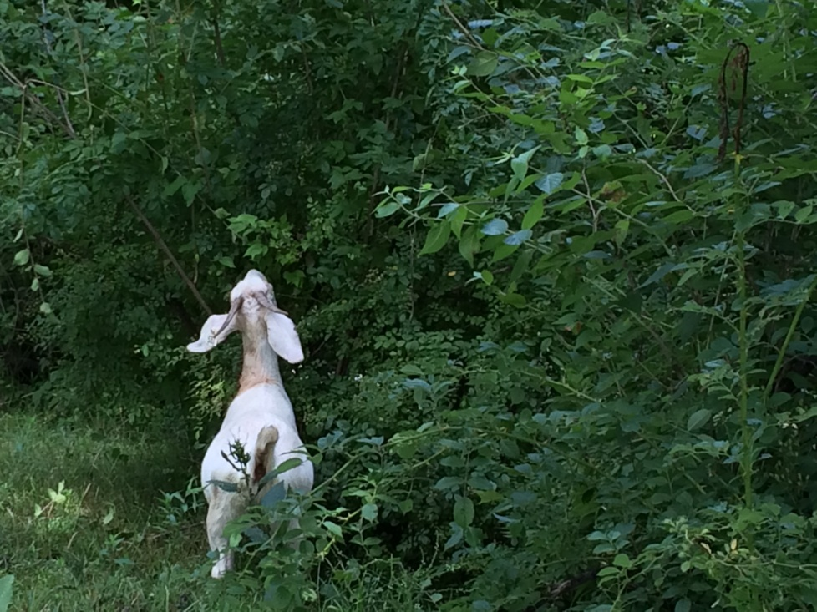
Meat Goat Production for Ethnic Populations
Thank you!
Q & A

Slide 27
Religious Preferences
Halal Certified
Killing done by a Muslim
Throat, windpipe and jugular veins are cut by means of a sharp knife
Animal must be fully conscious; stunning prohibited
Animal held upright before and during slaughter
Blood drained out completely

Slide 28
Religious Preferences
Kosher
Comply with Jewish dietary law
Meaning “fit”
Standards taken from Torah/first 5 books of Bible
Land animals that are ritually clean are those that chew their cud and have completely split hoof
Animal must be conscious
Specifications as to how to draw the knife across the throat, certain inner parts and fats to be removed
Meat is soaked and salted to completely draw out ALL blood.

